Slide 1
Module : OP&E Tools
Promotion Management

Slide 2
Sign-off Control Section
Name | First Name | Function | Document Version | Date | Signature
Le Maout | Robert | TME University lead | Final
Witt | Matthew | Laptop Deployment lead | Final

Slide 3
Objectives of this module
After this module, you will be able to
  Understand how the TME applications support the BP processes for Promotion Management
  Create Clusters in Siebel Marketing and use them in Siebel Sales CG
  Create Promotions Programs and cascade them to multiple accounts
  Review Promotion data in Siebel Analytics
Notes:
Review key objectives as documented on the slide with your participants.

Slide 4
Table of contents
Introduction to Better Practices for Promotion Management
  Definition
  Process Overview
  Capability Interdependencies
Tool support for Promotion Management processes
  JTI versus Siebel Terms
  Tool support
  Tool step overview by BP process
  Tool steps in detail
Demo & Exercises
  Tool demo
  Exercises

Slide 5
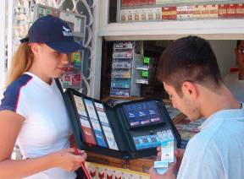
Introduction
Promotion Management - Definition
Promotion Management:
  Promotion Management is the process of planning, budgeting, presenting and executing trade and consumer promotions programs that are developed to increase trial, retention or generate Brand awareness in order to enhance the distribution and sales of specific products / Brands and contribute to build Brand equity. All these activities may have a margin impact.
  Promotion include various Trade
  Marketing approaches
    Consumer level promotion:
      awareness
      image
      loyalty
      trial
      gift
    Outlet level promotion:
      Planogram
      Compliance
    Price:
      price
      deco pack
      pack insert

Slide 6
Introduction
Promotion Management – Process Overview
Process Overview
Process Description
G1
Review output from ASP & ATL
Com. program
G1
Review ASP and ATL communication program in order to understand the type of promotions that will meet the brand objectives within the targeted channel / segment.
G2
Develop brand ann. promotion program(generic)
G2
Develop brand annual promotion program per
Channel / Segment / Cluster (yearly). (Only for non strategic accounts / outlets)
G3
Develop promotion plan per cycle (generic)
G3
Develop promotion plan by brand based on brand annual promotion program, providing more details about the promotions to be carried out during the coming trade marketing cycle.
G4
Develop brand ann. promotion program (strateg)
G4
Develop the brand annual promotion program by account / outlet, taking consumer characteristics, the role of the tobacco category and account / outlet characteristics into account.
G5
Develop the promotion plan per cycle(strateg)
G5
Develop the promotion plan by brand by account / outlet - taking consumer characteristics, the role of the tobacco category and account / outlet characteristics into account.
G6
Develop promotion materials
G6
Collaborate with selected consumer-oriented agencies to design and procure promotion materials based on the brand annual promotion program and the promotion plan by brand.
G7
Ensure execution & deployment in POP / POC
G7
Communicate promotion instructions and guidelines. Ensure deployment of promotions in POP / POC.
G8
Perform milestone
measurement & re-cast
G8
Track promotional performance on a regular basis and take corrective actions.
G9
Evaluate
promotion
efficiency &
effectiveness
G9
Measure the promotion compliance against promotion agreement and implementation plan. Measure promotion effectiveness and efficiency. Issue overall evaluation.

Slide 7
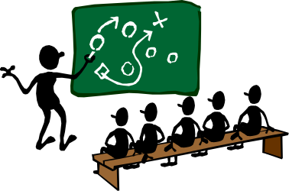
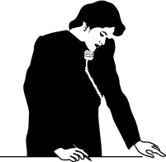


Introduction
Promotion Management – Interdependencies
Promotion Management concerns 3 TME roles:
  The Category Developer
  The Trade Marketer
  The Operational Planner
Brand Mgmt
Channel/Segment Mgmt
Key Account Mgmt
→ Strategies, Objectives and Guidelines
Category Developer
Operational Planner
Trade Marketer
Responsible for
Reviewing historical data in Siebel Analytics
Planning and setting up new Promotions in Siebel Sales CG
Measuring Promotion effectiveness
Responsible for
Preparing the work plan for the Trade Marketers using Siebel Sales CG
Analyzing the TM effectiveness in Siebel Analytics
Responsible for
Ensuring compliance of the promotion at the POC/POP
Executing promotion activities
Providing input in Siebel Sales CG during Outlet visits
Notes:
Verify the caller’s contact and address information by opening the Account Address multi-value group (MVG). If the appropriate address does not exist, you can create a new one by clicking the New button on the MVG and entering the information.

Slide 8

Introduction
Promotion Management – Interdependencies
Trade
Marketers
Brand
Channel & Segment
Account Mgmt
Guidelines
Objectives
Strategies
Channel/Segment
Program Guidelines
Visit Reporting
Agreements
Retail audits
Review ASP &
ATL communication program
1
Measure promotion efficiency & effectiveness
Generic
9
Category Developer
2
4
Develop brand annual
promotion program
Strat.
Plan visits & activities
Perform milestone measurement during promotion
Generic
8
3
5
Promotion
Management
Develop promotion plan
Strat.
7
6
Develop promotion materials
Detail & Assign
Promotion activities
Ensure execution
and deployment at PoP/PoC
Operational
Planner
Procurement
Agencies

Slide 9
Table of contents
Introduction to Better Practices for Promotion Management
  Definition
  Process Overview
  Capability Interdependencies
Tool support for Promotion Management processes
  JTI versus Siebel Terms
  Tool support
  Tool step overview by BP process
  Tool steps in detail
Demo & Exercises
  Tool demo
  Exercises

Slide 10
Tool support for Promotion Management
JTI versus Siebel Terms
JTI term
Siebel term:
Budget Budget
Brand Promotion Promotion Program
Promotion Plan Promotion
Budgets
A Budget is a named appropriation of money to be spent on promotions over a specific period of time specific categories and products.
Budgets are fixed amounts of money allocated in a lump sum.
The Category Developer sets up budgets based on information from the ASP
  A Budget can be split into child budgets.
Budgets are created by authorized users.
Money can be transferred between budgets. An approval process is available to manage this functionality.
A budget can be created for a specific brand if necessary.

Slide 11
Tool support for Promotion Management
JTI versus Siebel Terms
Promotion Programs & Promotions
Promotions include Promotion Programs and Promotions
Promotion Programs are at the corporate level, supporting products or brands. They correspond to Brand Promotions in JTI.
  Promotion Programs are created and maintained by the Category Developer.
  Data captured for that kind of Promotion mainly deals with period, recommended methods, high level objectives and additional high level information, and attachments.
Promotions are a subset of Promotion Programs, declined at a lower level, to smaller groups of accounts. One promotion is generated by the system for each account of the list.

Slide 12
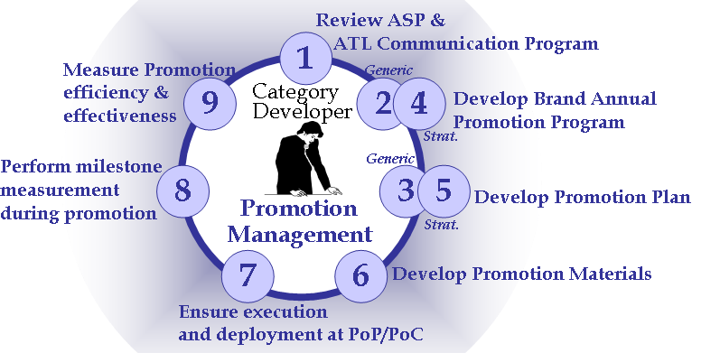
G.1. Review ASP & ATL Communication Program
Tool Support
Input:
From who What
Tool
support
Objectives
Specific Reqs
Process
action
Brand Marketing
Channel / Segment /
Account Manager
Category
Developer reviews promotion requirements
via File Upload
Siebel
Sales
Specific Reqs
“Literature” screen
“Attachments” view:
Specific requirements related to Promotion Program
Category Developer

Slide 13
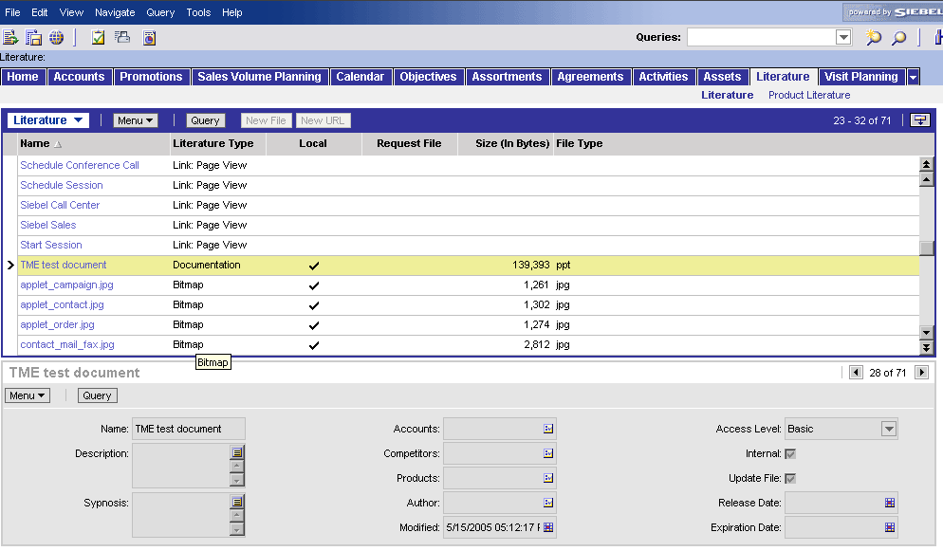
G.1. Review ASP & ATL Communication Program
The “Literature” screen (1/2)
View:
Tool actions:
  Literature screen shows all information which can be downloaded for different purposes: APSP, catalogues, Sales presentations, contracts, etc.
  Access to the files depends on your user rights
  Searching for a specific file can be done through vertical scrolling or using the Query Function

Slide 14
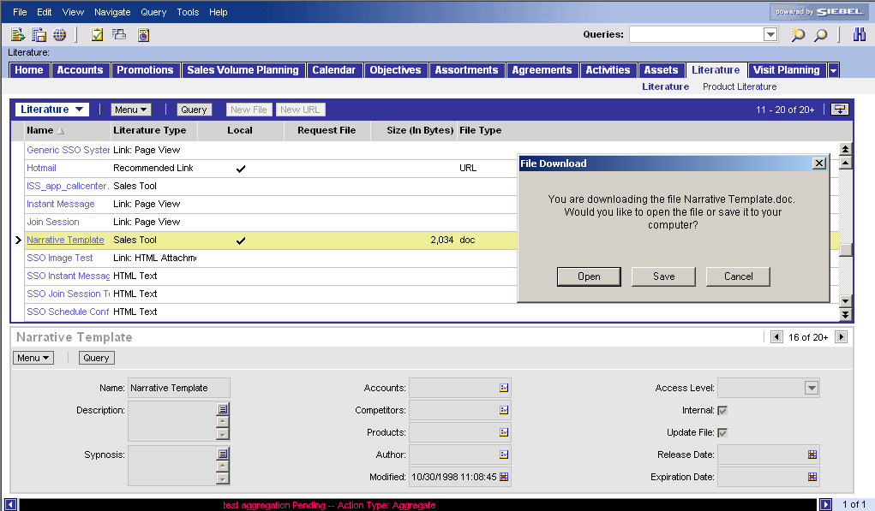
G.1. Review ASP & ATL Communication Program
The “Literature” screen (2/2)
How to access file in Literature screen
Access the “Literature” screen (click on Tab “Literature”)
Search document
  by scrolling down (drag scroll bar with mouse)
  by using the query function (click on query and fill in fields to narrow the selection of the list of files in the Literature view)
Open the file
  Click on file
  Choose “Open” or “Save” (to have local copy on hard drive)
1
2a
3a
3b
2b
You can not modify files in the Library, only local copies of the file on your hard drive

Slide 15

G.2. / G.4. Brand Annual Promotion Program
Tool steps
The Category Developer prepares centrally the
promotions that are to be executed at outlet level.
The tool navigation is the same for strategic and
non strategic accounts.
Create a Budget
Sales
Create a Promotion Program
Select a validity period
Check Calendar
Define objectives
Define Promoted Products
Add promotion material
Select and Check budget

Slide 16
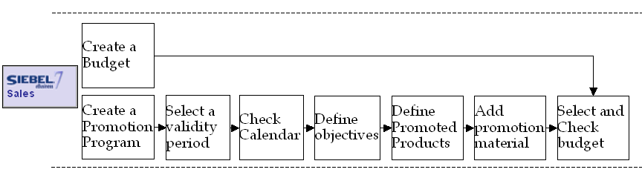
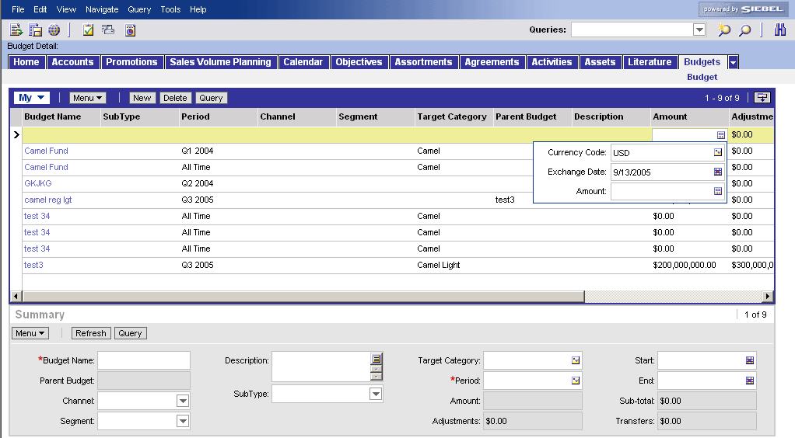
G.2. / G.4. Brand Annual Promotion Program
Create a budget
Create a new budget
Add new Budget
Go to screen “Budget”
Click “New” button in the list applet at the top
1
2
3d
Fill out first the mandatory fields
  Fill in name of new Budget in the column “Budget Name”
  Indicate the period during which the Budget is valid by picking a period in the pick applet used to populate the “Period” column
  The fields “start date” and “end date” are automatically updated
  Add the budget amount in the “Amount” column
3a
3c
3b

Slide 17
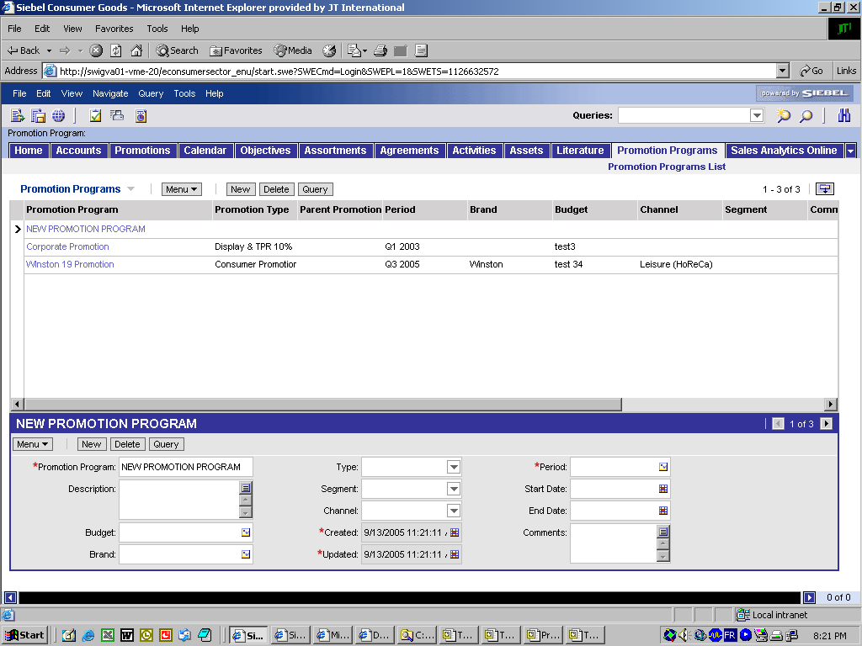
G.2. / G.4. Brand Annual Promotion Program
Create a promotion program
The Category Developer creates a new
Promotion Program
Add new Promotion Program
Go to screen “Promotion Program”
Click “New” button in form applet
Fill out mandatory fields
  Name of new Program in the field “Promotion Program”
  Select period of the Program by opening the pick applet within the Period field and choosing one period
  Fields “start date” and “end date” are automatically updated according to the period
1
2
3a
3b
3c

Slide 18
G.2. / G.4. Brand Annual Promotion Program
Create a promotion program
Complete fields for the new Promotion
Program
Complete main fields for a Promotion Program
Select from a pick applet the Budget (created earlier)
Describe in more detail the program (use the upper text field button)
Add other instructions/comments
The fields “Channel” and “Segment” are purely informative and non-mandatory
2
1
3

Slide 19
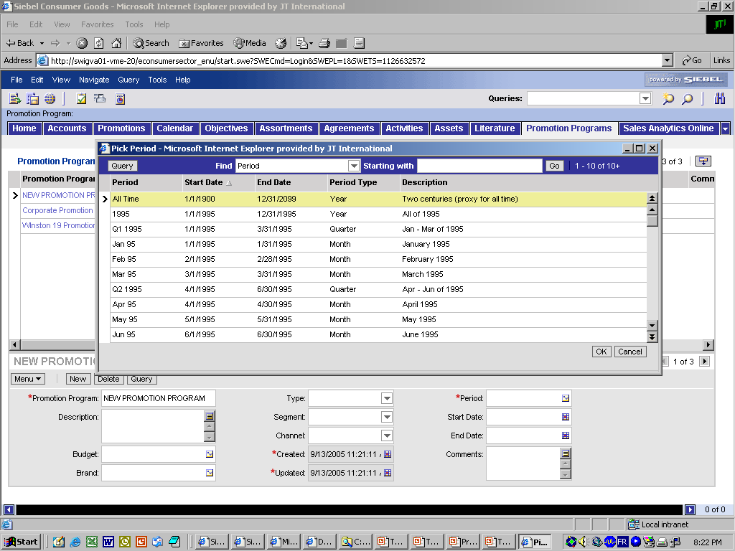
G.2. / G.4. Brand Annual Promotion Program
Create a period
Example of pick applet for “Period”:
This pick applet is similar to the one
for the fields “Budget” and “Account”
2
3
4
You can only pick one single value
1
Select a Period
Search for the record by scrolling or using the field “Starting with:” (add letters and press Go)
Click on the preferred record: it will turn yellow
Press OK

Slide 20
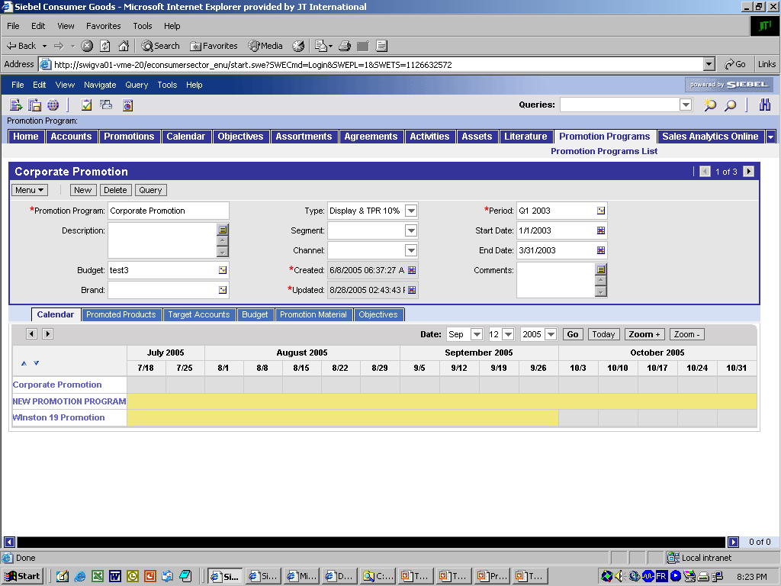
G.2. / G.4. Brand Annual Promotion Program
Check overlap in terms of timing
Check the timing of the Promotion Program
against the other Promotion Programs
  The Calendar only shows Programs selected
  in the List Applet
Validate timing of Promotion Program
Go to view “Calendar”
Navigate to the right time period
  Select a date and press go
  Zoom “in” or “out” to change range
Compare overlap between different Promotion Programs
Change period if needed (pick applet)
4
1
2a
2b
3

Slide 21
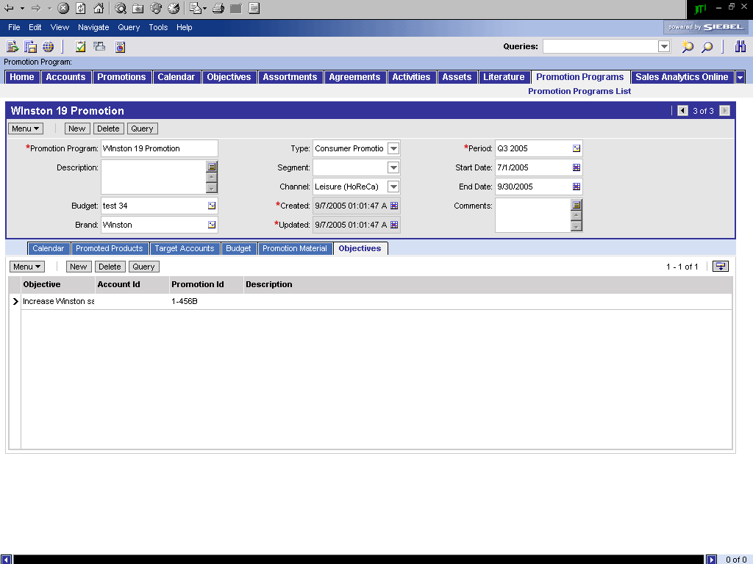
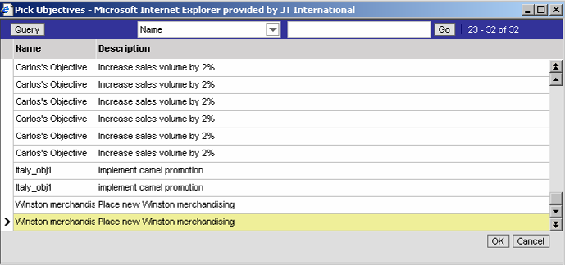
G.2. / G.4. Brand Annual Promotion Program
Define objectives for the promotion program
Define objectives for the Promotion Program
3
Define & document objectives
Go to “Objectives” view
Press “New” button
Select in Pick Applet objective.
Set as many objectives as needed
1
2
4

Slide 22
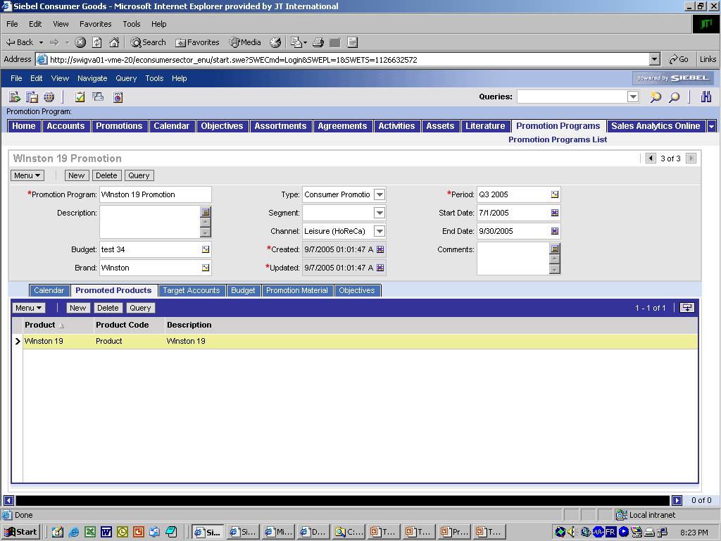
G.2. / G.4. Brand Annual Promotion Program
Select the promoted products
Define Products to be promoted
Define promoted products
Go to “Promoted Products” view
Press “New” button & select the each product in the Pick Applet.
Set as many Promoted Products as needed
1
2
3

Slide 23
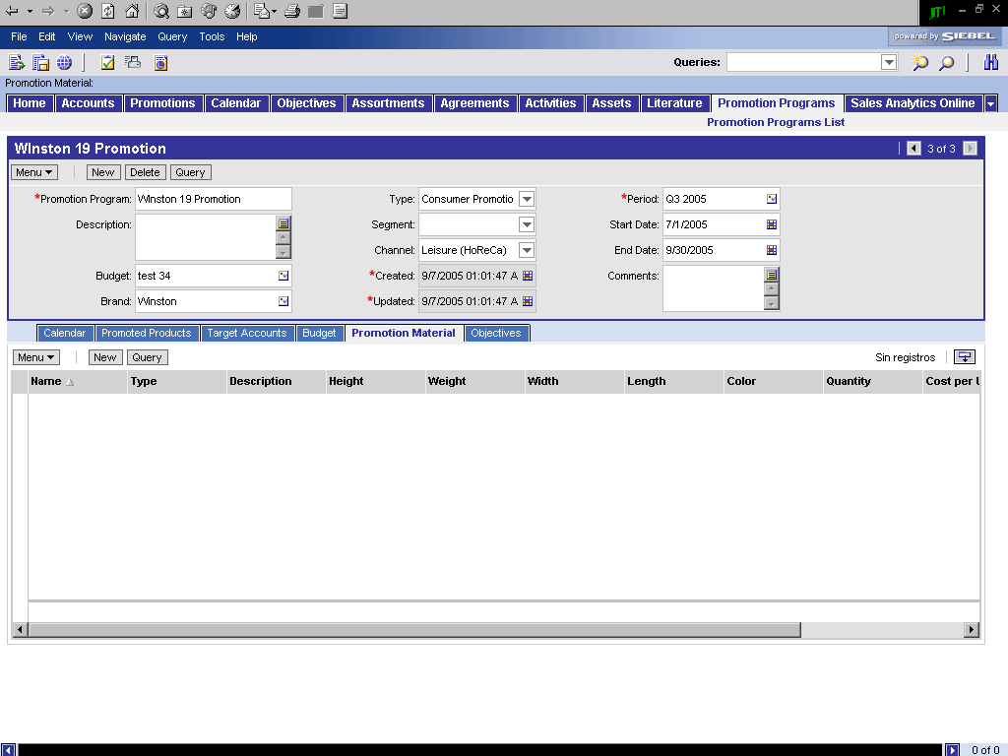
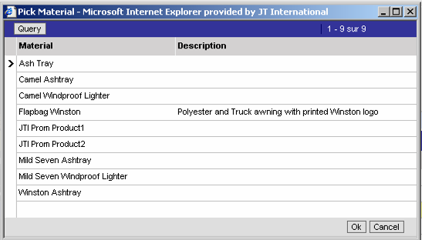
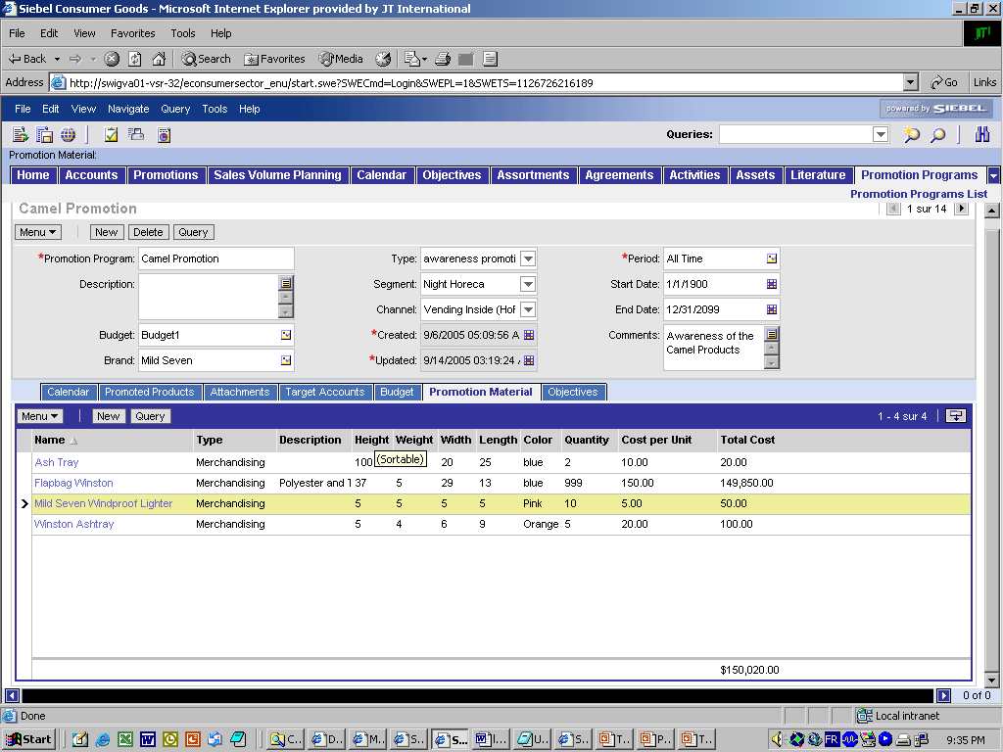
G.2. / G.4. Brand Annual Promotion Program
Select the promotion material
Define Promotion Material
Define Promotion Material
Go to “Promotion Material” view
Press “New” button
Select each material in the Pick Applet
Characteristics of material is displayed
Enter Quantity, Price. Total cost is automatically calculated
The sum for the total cost is displayed at the bottom of the applet
3
1
2
4
5
6

Slide 24
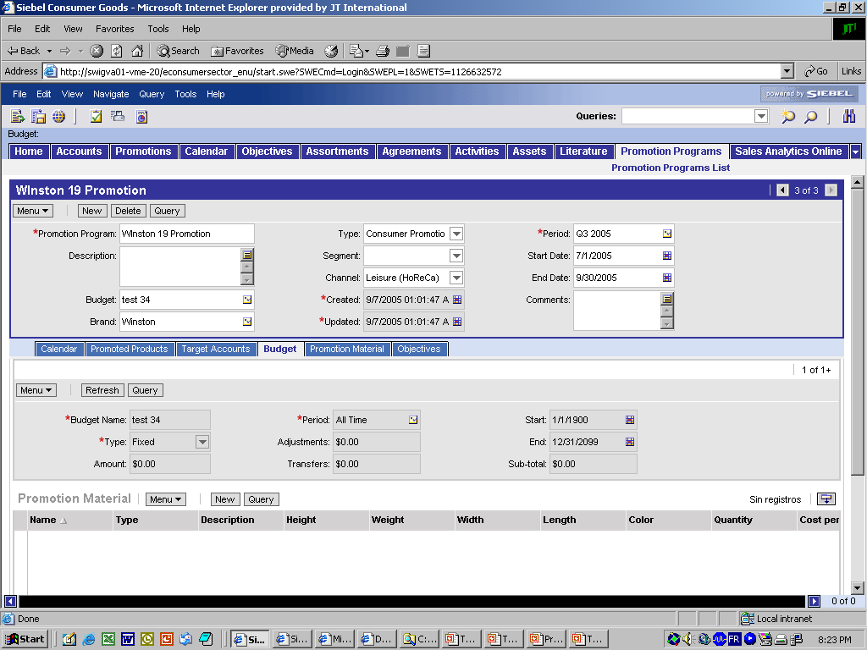
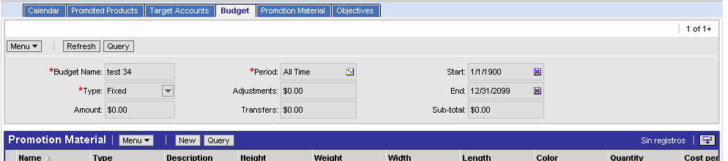
G.2. / G.4. Brand Annual Promotion Program
Check program cost versus the budget
Check budget
Budget vs Cost analysis
Go to “Budgets” view
Compare planned budget amount and planned total cost
1
Form applet
with budget details
2
List of promotion material
2

Slide 25

G.3. / G.5. Communicate Promotion Plan
Tool steps
Communicating the Promotion Plan means making
it available (visible) to all targeted outlets.
  The Category Manager defines to which kind
  of outlets the promotion should be applied to.
  With this information, the Operational Planner, knowing the field, creates the cluster/target list and applies this list to the Promotion Plan. By pressing the „Commit“ button in the „Target Accounts“ view of the Promotion Program, the tool creates Promotions (duplicates) for all the targeted accounts. This is the actual communication within the tool.
Create a cluster of outlets (segment)
Marketing
Create a List and import Accounts
Go to the created Promotion Program
Select accounts (Target List or manual) and apply
Check deployment of the Promotion Program in the Promotions Plans
Sales

Slide 26
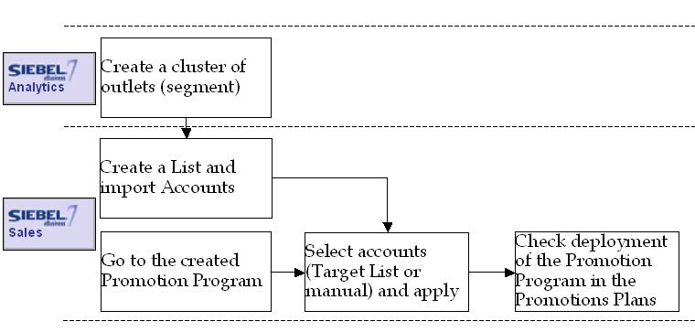
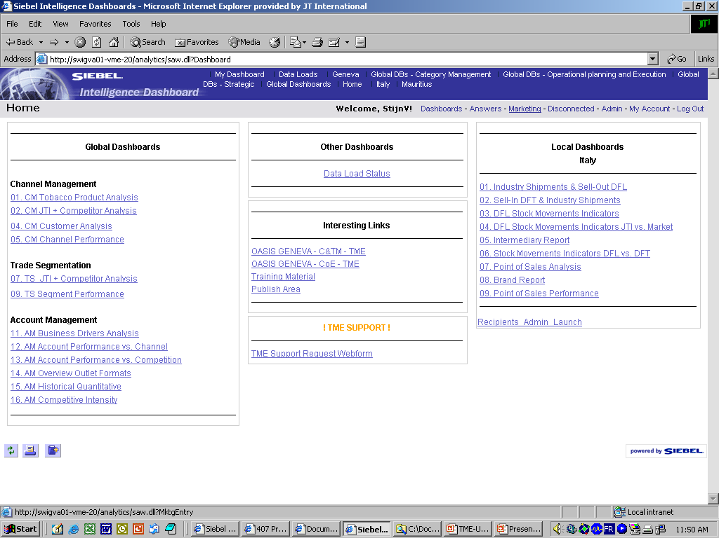
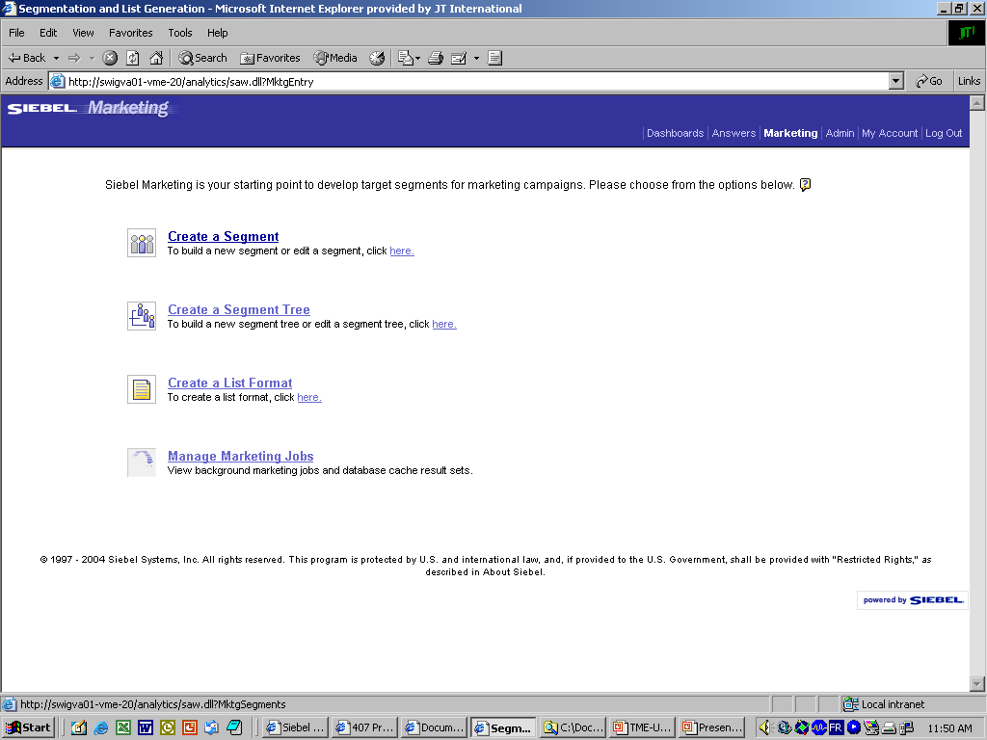
G.3. / G.5. Communicate Promotion Plan
Create a cluster
Create a cluster (1/3)
1a
1b
2
Navigate to Siebel Marketing Analytics
  Login into Siebel Analytics (Insight)
  Click on ‘Marketing’ in the Menu bar
Click Create a Segment

Slide 27
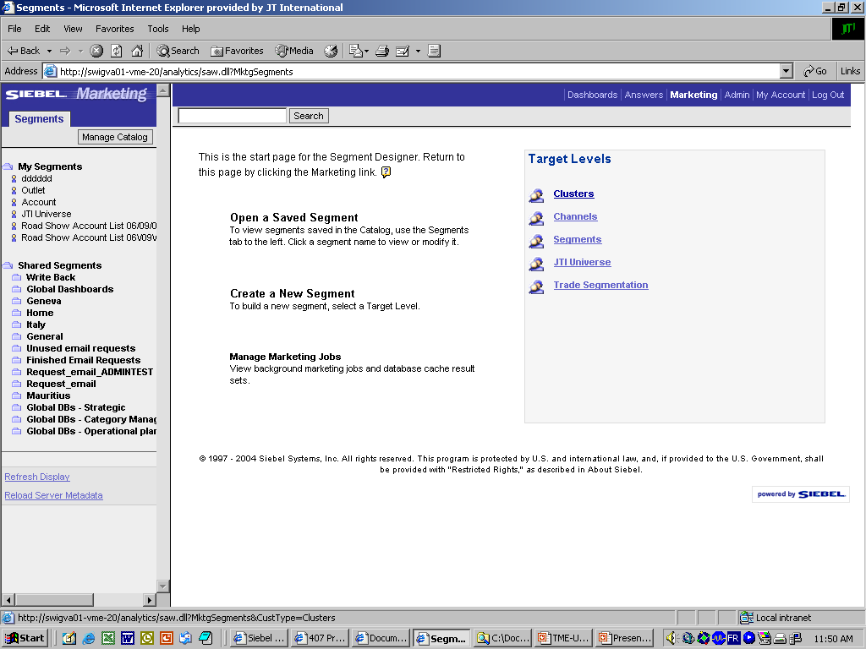
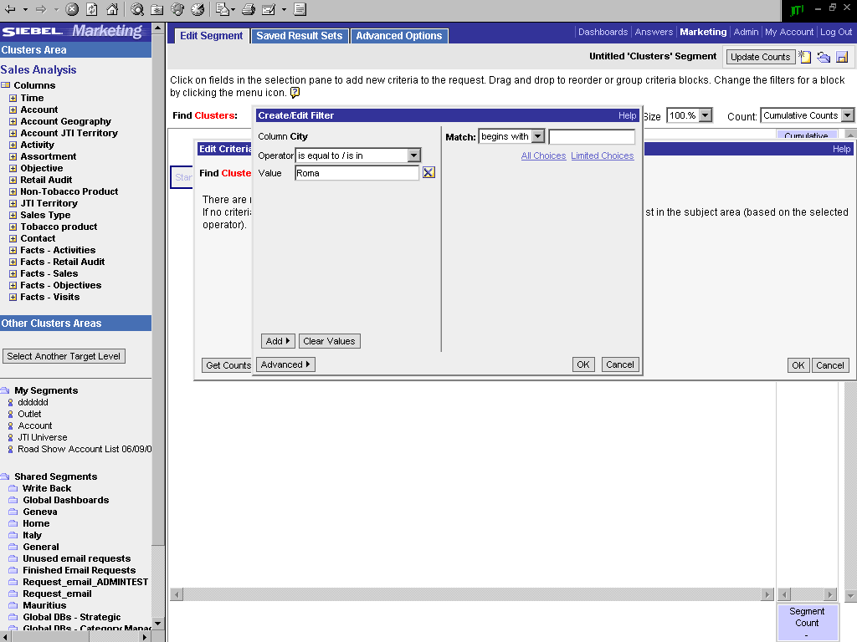
G.3. / G.5. Communicate Promotion Plan
Create a cluster
Create a cluster (2/3)
1
2a
2b
2c
2d
Select the cluster level to be created
To create a new cluster, define the variables:
  Choose among variables
  For each variable, define search method: Operator
  And enter value
  Click OK
Clusters created by the user
Shared clusters

Slide 28
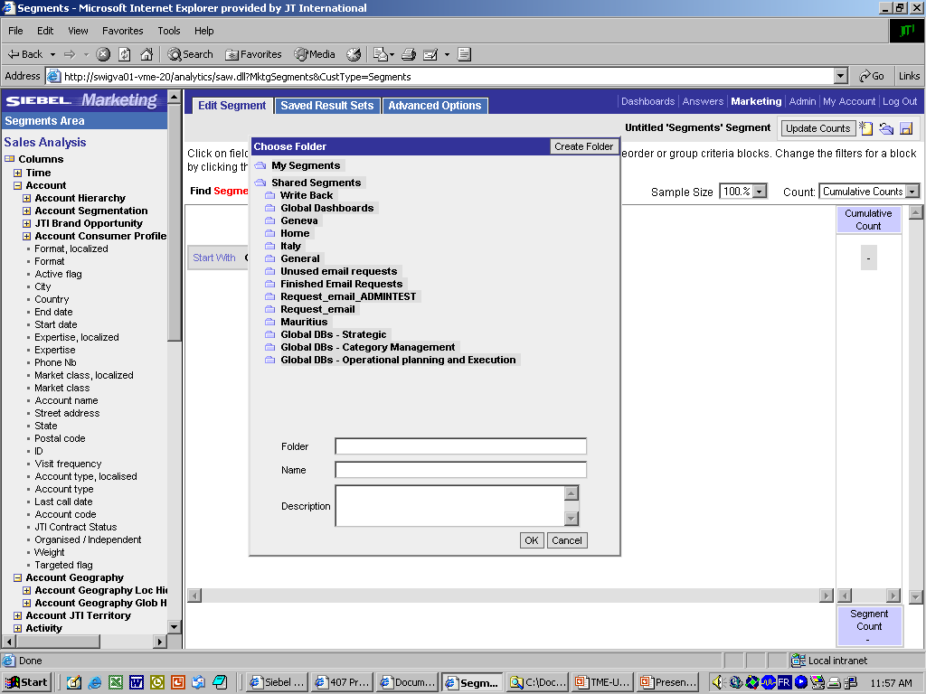
G.3. / G.5. Communicate Promotion Plan
Create a cluster
Create a cluster (3/3)
  Save the created cluster
1
2
2a
Click the Save icon
Save:
  Select a folder where you want to save the Cluster
  BE AWARE! The value shown in the field “Folder” is equal to the value you will have to add later in the field “Analytics Path” when importing the cluster within a Target List in Siebel Sales
  Enter name for the cluster
  BE AWARE! The value shown in the field “Name” is equal to the value you will have to add later in the field “Segment Name” when importing the cluster within a Target List in Siebel Sales
2b

Slide 29
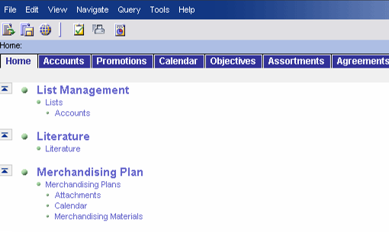
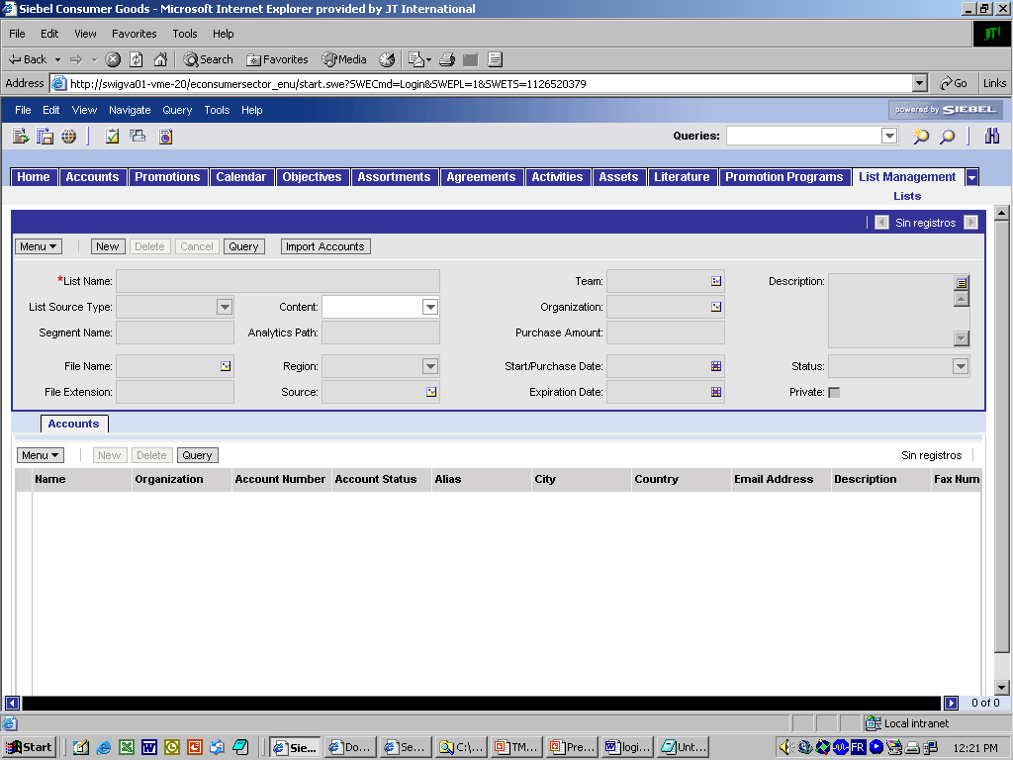
G.3. / G.5. Communicate Promotion Plan
Create a target list based on the cluster
Import the cluster in Siebel Sales
  Within Sales you create a Target List and load all
  the accounts from the cluster within („Import“)
1
2a
2b
Log into Siebel Sales CG
Navigate to the List Management functionality
  Go to the site Map
  Go to the List Management/ Lists/Accounts view
Create a new list that will contain the cluster
  Click New
  Enter List Name
  Choose value ‘Targeted List’ in the List source type drop-down menu
  Enter the Analytics Path for Siebel to import the correct values (The “Folder”)
  Enter exact name of the Segment created in Analytics
Click ‘Import Accounts’
The accounts are listed in the bottom list-applet
3a
4
3b
3c
3e
3d
5

Slide 30
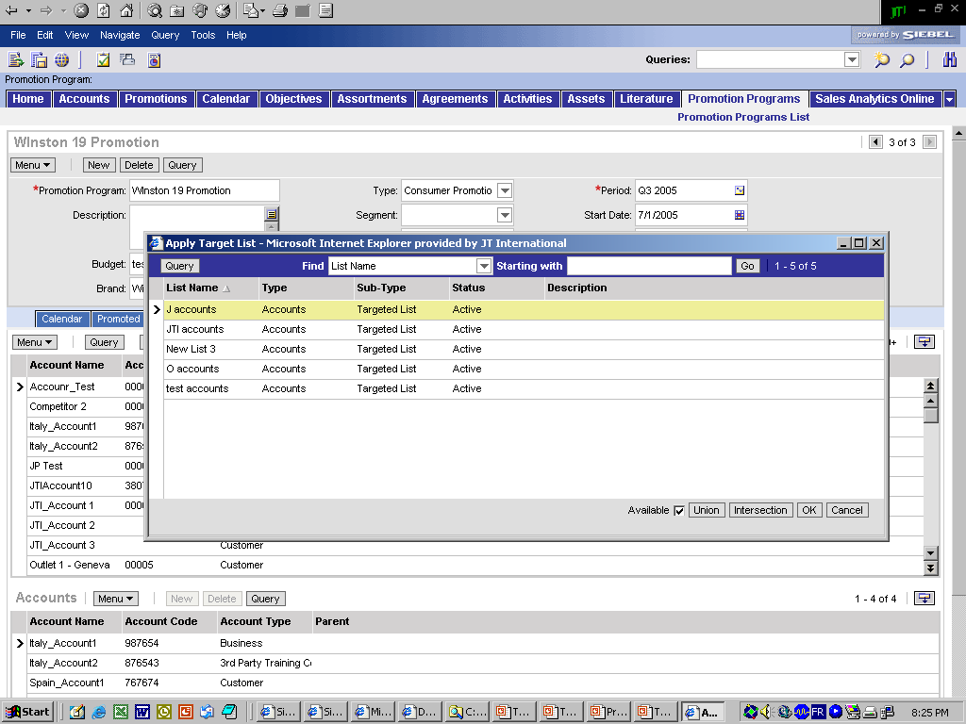
G.3. / G.5. Communicate Promotion Plan
Apply the target list to the promotion program
Add accounts to the Promotion Program
2a
Add accounts in the Promotion Program
Navigate to the Target Account view
Picking a Target List
  Click on the Target List icon.
  In the pick-applet window, select the List and click OK
The middle list-applet of accounts is replaced by only the accounts contained in the Target List
Select all accounts (Ctrl+A)
Click the ‘Commit’ button
The accounts are now added in the bottom list, and applied to the Promotion Program
Detail-applet of the record
2b
List-applet of accounts
3+4
List-applet of accounts
applied to the Promotion Program
6

Slide 31
G.3. / G.5. Communicate Promotion Plan
Apply the promotion program via “Commit”
Apply the promotion program
  By pressing the „Commit“ button in the „Target
  Accounts“ view of the Promotion Program, the
  tool creates Promotions (duplicates) for all the
  targeted accounts. This is the actual communication within the tool.
Commit
Promotion Program
Promotion ‘X’ for account 1
Promotion Program ‘X’
With n accounts
Promotion ‘X’ for account 2
Promotion ‘X’ for account 3
Promotion ‘X’ for account 4
Promotion ‘X’ for account n
Promotion Program screen
Promotions screen

Slide 32
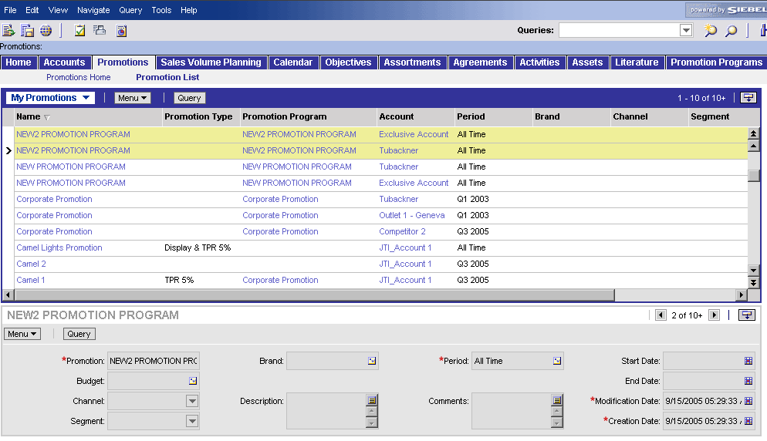
G.3. / G.5. Communicate Promotion Plan
Check deployment
Check program deployment
  In the ‘Promotions’ screen, the created Promotion
  Program should appear as many times as there are
  outlets in the Promotion Program
1a
1b
2b
2c
2a
Check Promotions and Promotions Programs per Accounts
Navigate to the Promotion List view
  Click on the Promotion screen tab
  Click on the Promotion List link
Check program deployment
  The column ‘Name’ displays the names of the Promotions per account (by default, name is the same as the Promotion Program)
  The column ‘Promotion Program’ displays the related Promotion Program
  The column ‘Account’ displays the accounts related to each Promotion

Slide 33

G.6. Develop Promotion Materials
Tool support
How do you develop Promotion Materials?
Better Practice process steps
  Design promotion materials
  Get approval on materials
  Procure promotion materials
    Siebel Laptop can support the user by providing contact information for relevant design agencies, e.g. “Attachments” view within a Promotion Program
Siebel
Sales

Slide 34
G.7. Ensure execution and deployment at PoP/PoC
Tool steps
Once the Promotion is set up, the execution of the
supporting activities must be ensured.
The execution phase is mostly covered by the
capability “Execution at POP/POC”.
The purpose of this step is to communicate the promotions to the operational planner so that he creates the Trade Marketing Activities to support the promotion, and to control the proper execution.
Create promotion and guidelines
Category Developer
Create TM activity objective
Create visit activities for TM
Target and apply the activities
Schedule activities within a visit
Ref. to module
Operational
Planning
Sales
Operational
Planner
Execute Activities
Ref. to module
Execution at
POC/POP
Trade Marketers

Slide 35
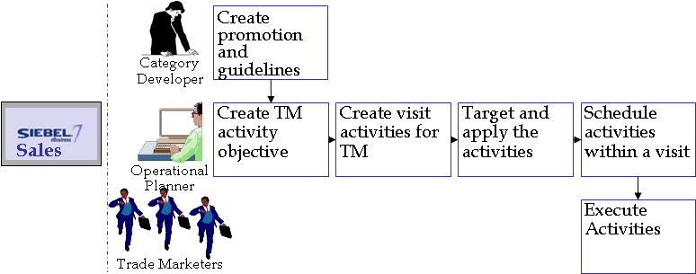
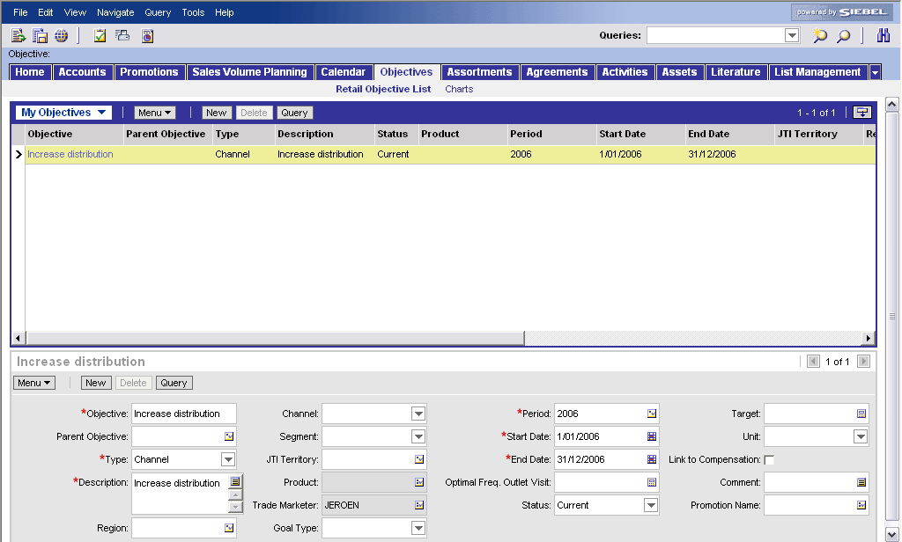
G.7. Ensure execution and deployment at PoP/PoC
Create Trade Marketing Activity objective
Create a Trade Marketing Activity objective
  This objective describes the overall goal of the
  supporting activities and it must be linked to the
  promotion program E.g. "Support promotion
  XXX by placing material YYY and checking compliance"
1
2
Create objective of “Trade Marketing Activity” type
Navigate to the Objectives screen
Click New
Enter Objective Name
Select Objective type “Trade Marketing Activity”
Describe high level what activities should support this objective and how
Select the Promotion Program it supports
Select the period (time period for active status)
Objective Types:
Strategic Objectives
  Brand
  Channel
  Segment
  Key Account
Operational Objectives
  Region
  District
  Area
  Territory
  Outlet
Trade Marketing Activity
3
7
4
5
6

Slide 36
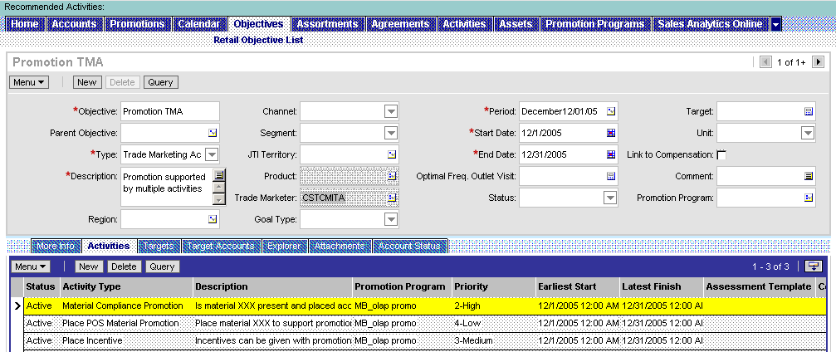
G.7. Ensure execution and deployment at PoP/PoC
Create Trade Marketer (visit) activities
Create Activities for the Trade Marketer
  The Operational Planner creates very specific, detailed
  activities that support the TM Activity objective and
  the implementation of the promotion program. These
  will be organized by visit.
  Typical Promotion supporting activities are:
    on 04.11.05 go to outlet XXX and place item 1234 (Poster) in the store
    at the latest by 30.11.05 go to outlet XXX and check the promotion compliance
Create a (visit) activity
Go to the “Activities” view in the “Objectives” screen
Click the “New” button in the list applet at the bottom
Fill out first the mandatory fields
  Fill in the Activity Type
  Fill in the Description
  Promotion Program
  Priority
Specify Earliest Start and Latest Finish Date in case not equal to the period of the TM Activity objective (should be between Start and End date of this period)
Activity Types for Promotion:
Place POSM Promotion material
Material Compliance Promotion
Place Incentive
1
2
3
4

Slide 37
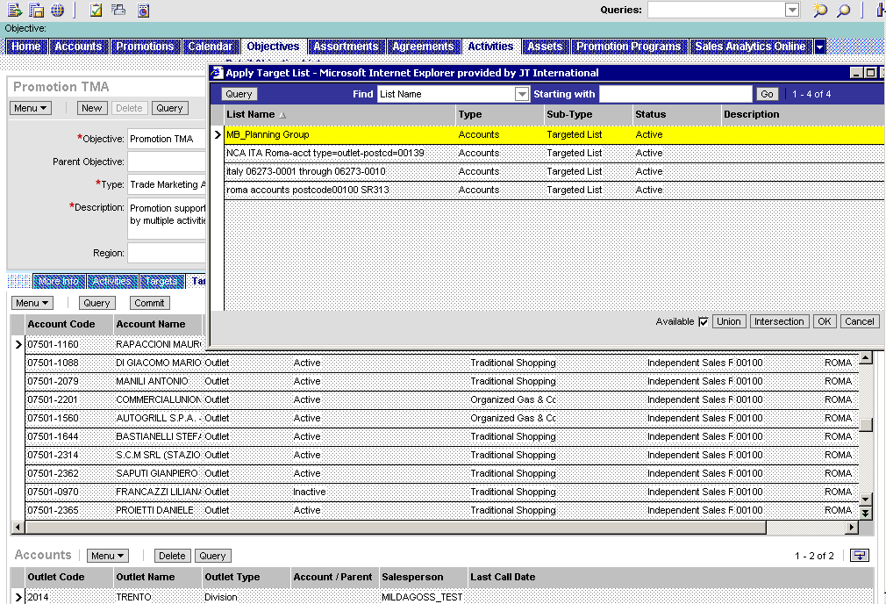
G.7. Ensure execution and deployment at PoP/PoC Target Trade Marketer (visit) activities
Select the target accounts for the created activities
  Re-use the target list you used to apply the
  promotion program in order to assign the
  supporting activities to the same accounts
2
3
1
Select the target accounts where the activities need to be executed.
Logically these are the same as the ones in the target accounts of the related promotion. Therefore it is advised to reuse the same target list
Go to the “Target Accounts” view in the “Objectives” screen (still in for the same “TM activity objective”
Press the “Apply target list” button
Double-click the target list you linked to the promotion program
Select all accounts (Ctrl+A)
Press “Commit” button
The accounts appear in the bottom window
5
4
6

Slide 38
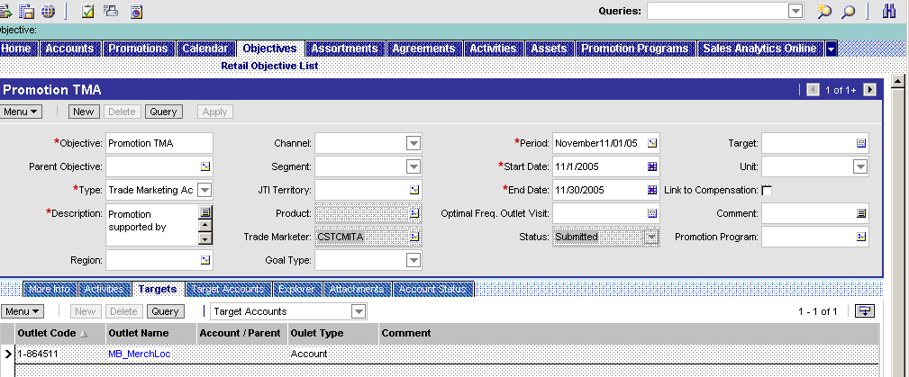
G.7. Ensure execution and deployment at PoP/PoC Communicate Trade Marketer (visit) activities
Communicate (apply) the activities to the accounts
  Once the target accounts selected by the commit
  button in the “Target Accounts” view, you need
  to communicate the TM Activity objectives and its activities to the selected target accounts by pressing the “Apply” button in the “Targets” view.
3
1
Communicate the TM Activity objective and its visit activities to the target accounts
Go to the “Target” view
Review the final selection of Target Accounts
Press the “Apply” button
2

Slide 39
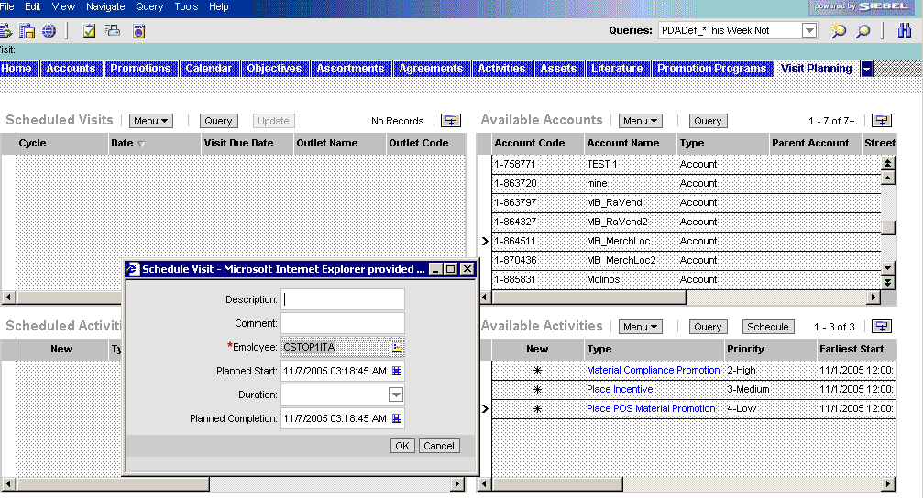
G.7. Ensure execution and deployment at PoP/PoC Schedule visit(s) for the activities
Group the activities by visits and plan
  This is a process the Operational Planner
  executes each cycle and which is automated. It is
  possible to still schedule a visit separately in the
  “Visit Planning” screen.
Compose and schedule a visit
Go to the “Visit Planning” screen
In the right upper list applet “Available accounts” select one of the targeted accounts
The earlier defined promotion visit activities will appear as “Available activities”. Select the ones you want to schedule a visit for
Press the “Schedule” button
Fill out the descriptive fields and press “OK”
1
2
4
3
5

Slide 40
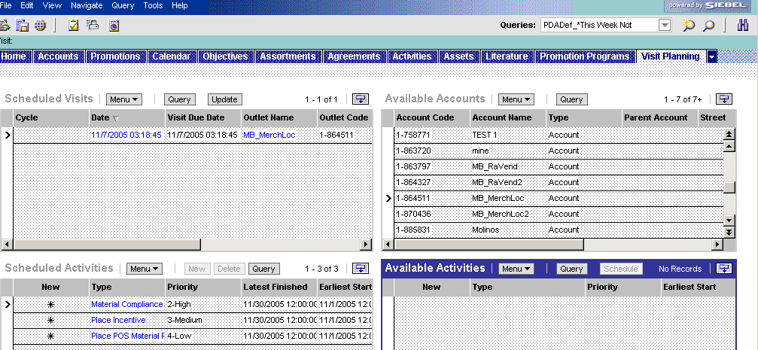
G.7. Ensure execution and deployment at PoP/PoC Schedule visit(s) for the activities
Review the activities and add if needed
  Review the activities for the scheduled visit(s)
  If new active activities are created within the
  period of the visit, you can press the “Update” button to include these.
Add new activities to the visit
(first create visit activity as described before)
Select the account in the right upper applet
The new activity will popup in the bottom applet “Available Activities”
Select the scheduled visit to which you want to add the activity
Press the “Update” button
The visit will appear in the left bottom applet “Scheduled visits” and disappear in the right bottom applet “Available activities”
4
3
1
5
2

Slide 41
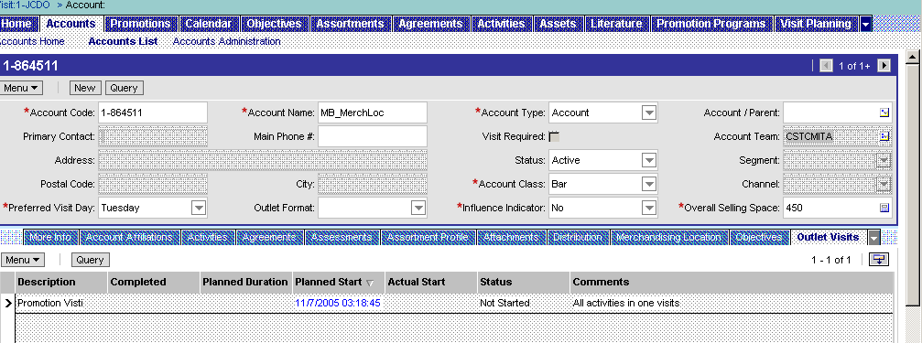
G.7. Ensure execution and deployment at PoP/PoC Access the outlet visit
The Trade Marketer can open his visits through
many ways such as his calendar. When going to the
specific targeted account (by the promotion and by
the related TM Activity objective and visit activities),
the Trade Marketer opens the visit in the “Outlet Visits” view of the account.
Open the visit
Navigate to the “Accounts List” view in the “Accounts” screen and drill down on the specific account
Open the “Outlet visits” view
Drill down on the visit you want to consult or execute
1
2
3

Slide 42
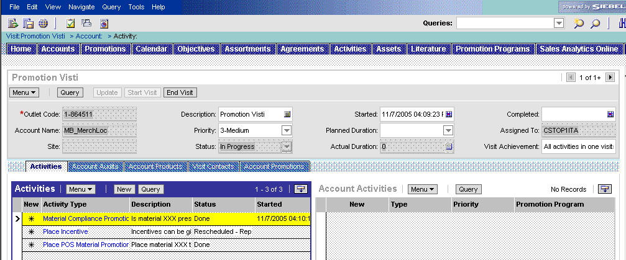
G.7. Ensure execution and deployment at PoP/PoC Start the visit and promotion activities execution
The Trade Marketer must start the visit (by clicking
on the “Start Visit” button) before being able to
execute the activities. (for visit tracking purposes)
In case the TMer cannot complete the activities during the visit, he puts
the status on “Rescheduled” so it becomes available again in the “Visit Planning” screen to schedule for a new visit.
Start the visit
Drill down on the visit and the “Activities” will be shown
Push the Start Visit button
Select the activity and fill in the “Started” field
Drill down on the visit (“Activity Type” field)
After completion of activity
Reset the status to “Done” or any other appropriate value and indicate the time of completion in the “Completed” field
After completion of visit (activities set to done or rescheduled)
Push the “End Visit” button
2
6
1
3
4
5

Slide 43
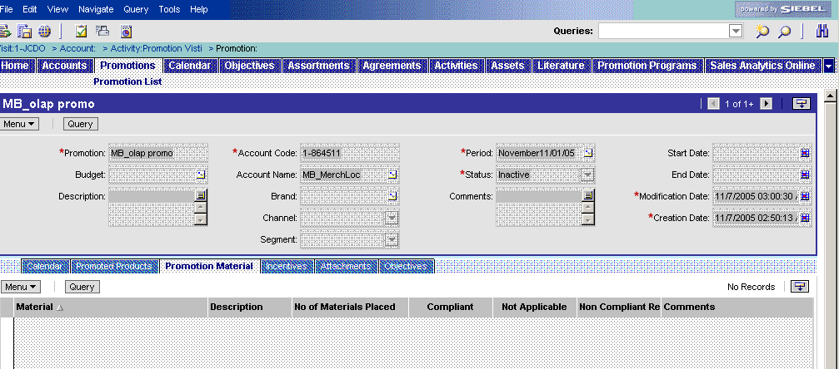
G.7. Ensure execution and deployment at PoP/PoC Promotion activity 2: Material compliance check
“Place POS Material Promotion” activity
  Drilling down on this activity will lead the Trade
  Marketer to the “Promotion Material” view of
  “Promotions’’ screen (one promotion of each target account)
  Review the material to be placed and indicate the number placed
Execute a “Promotion Material Placement”
Drill down on the activity in the “Activities” view and the “Promotion Material” view will open
Review the requirements according the Promotion Program in terms of types of material and their description
Indicate how many materials you placed
1
2
3

Slide 44
G.7. Ensure execution and deployment at PoP/PoC Promotion activity 1: Material placement
“Material Compliance Promotion” activity
  During next visit(s), the Trade Marketer will
  check whether the placed material is still
  compliant to the guidelines of the promotion program
  Exactly the same view as previous activity, but other fields are filled out
Execute a “Promotion Material Compliance check”
Drill down on the activity in the “Activities” view and the “Promotion Material” view will open
Review which Promotion materials have been placed during earlier visit
Indicate whether the current situation is still compliant according the requirements (details attached or in description of Promotion Program)
Historic analysis on compliance:
All this data will be transferred to the OLAP datawarehouse from which Siebel Analytics will feed the Promotion dashboards
1
2
3

Slide 45
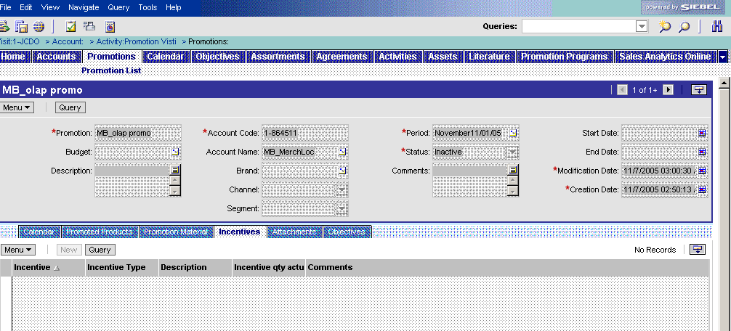
G.7. Ensure execution and deployment at PoP/PoC Promotion activity 3: Place incentive
“Material Compliance Promotion” activity
  The Category Developer will have defined which
  incentives can be awarded and under which
  conditions. The tracking of incentives occurs through the “Material Compliance Promotion” activity
Execute a “Incentive placement”
Drill down on the activity in the “Activities” view and the “Promotion Material” view will open
Review guidelines of the incentives for the specific promotion and their descriptions
Indicate how many incentives you placed
1
3
2

Slide 46
G.8. Milestone Measurement during Promotion
Tool steps
This step reviews the intermediate data collected
at POP/POC and enables corrective actions if
necessary.
  Data is collected in Siebel Sales CG.
  Analysis is performed in Siebel Analytics using Dashboards and Reports.
You can only select one program at a time
Select the Promotion program
Analyze the promotion material consumption
Analyze the promotion plan compliance and objective achievements
Analyze the promotion budget
Analyze the promotion incentive payment
Analytics
Dashboard page
Promotion
Selection
Promotion
material
consumption
Promotion
compliance
Promotion
budget
Promotion
Incentive
Payment

Slide 47
G.9. Measure Promotion Efficiency/Effectiveness
Tool steps
Siebel Analytics supports this process step to
measure the promotion efficiency.
  Data is consolidated as a document and
  uploaded into Siebel Sales CG for future
  promotions.
Reports defined for G.8 also apply to G.9
You can only select one program at a time
Select the Promotion program
Analyze the promotion material consumption
Analyze the promotion plan compliance and objective achievements
Analyze the promotion budget
Analyze the promotion incentive payment
Analytics
Dashboard page
Promotion
Selection
Promotion
material
consumption
Promotion
compliance
Promotion
budget
Promotion
Incentive
Payment

Slide 48
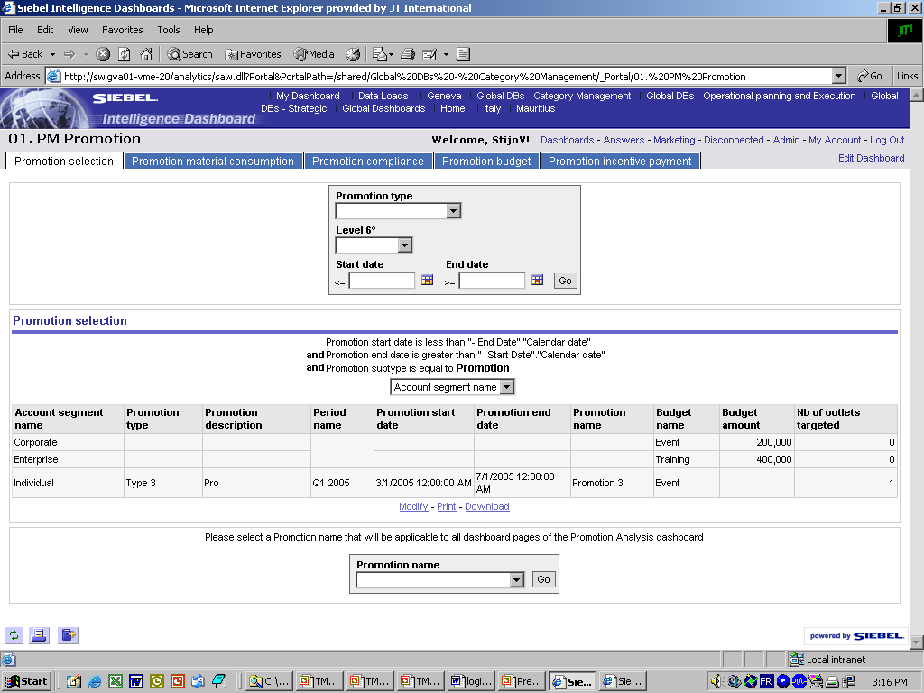
G.9. Measure Promotion Efficiency/Effectiveness
Dashboard – Promotion Selection
The 1st dashboard page is to select the Promotion Program to be analyzed in the later pages
Go to the “Promotion Management” dashboard by clicking on the link “Global DBs – Category Management
Select the “Promotion selection” page
Narrow down the list of programs by defining the global filters
  Select a Promotion Type
  Select a time period
  Press “Go”
By changing the column selector you can analyze the programs per channel or per segment
Select the Promotion Program that you want to analyze in the other 3 dashboard pages and press “Go”
The other pages will only show reports related to this selected program
1
2
3
4
5

Slide 49
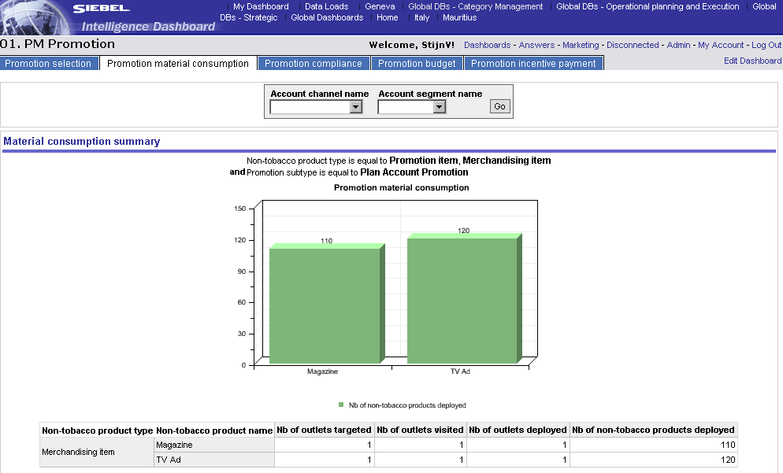
G.9. Measure Promotion Efficiency/Effectiveness
Dashboard – Promotion material consumption
Tracking and evaluation of the consumption of Promotion material by channel/segment
This dashboard pages allows reviewing of the consumption-to-date of the number of promotion articles that have been deployed within a certain channel or segment
Select filter and press “Go”
The table below shows calculation of the average consumption per outlet for each promotion material
1
Siebel Analytics

Slide 50
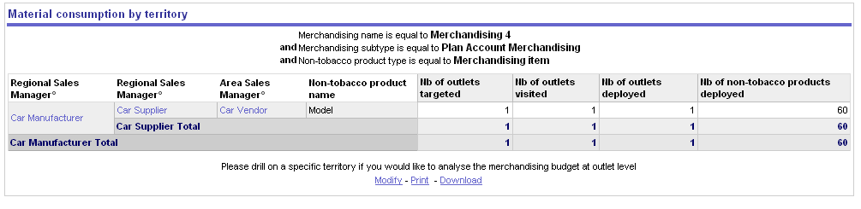
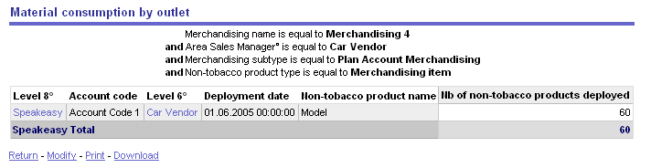
G.9. Measure Promotion Efficiency/Effectiveness
Dashboard – Promotion material consumption
Tracking and evaluation of the consumption of Promotion material by territory
This report shows consumption by geographic level. Drill down provides a more detailed view of the territory
Drill down on Trade Marketing code
Material consumption is shown on outlet level
Siebel Analytics
1
☺
2

Slide 51
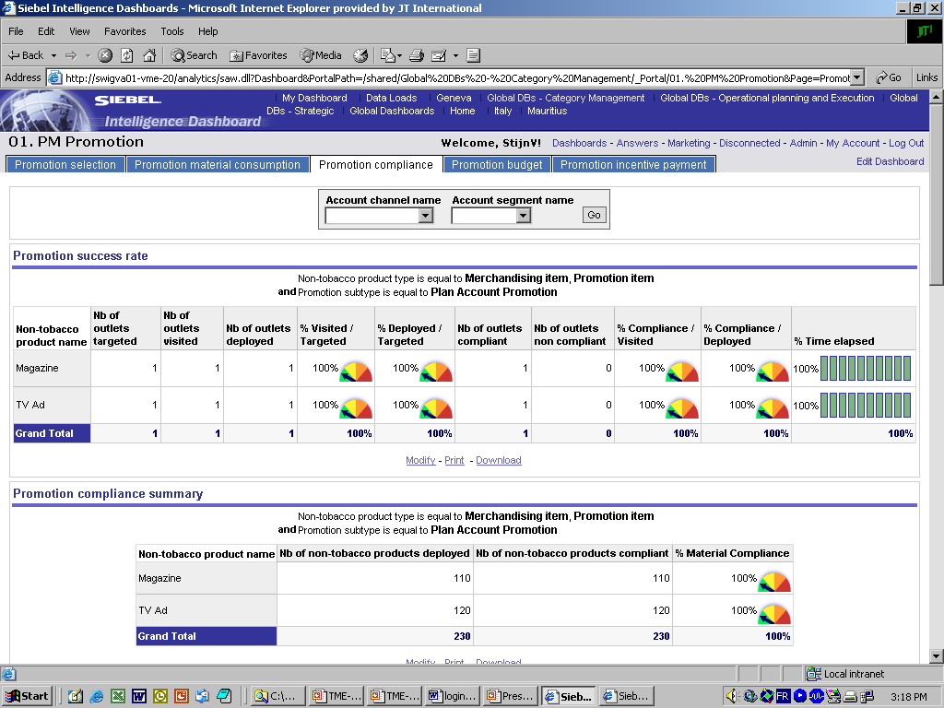
G.9. Measure Promotion Efficiency/Effectiveness
Dashboard – Promotion compliance
Measure & review success of a particular Promotion ?
Go to the “Promotion compliance” page
Filter the promotion products for a specific channel/segment by selecting a specific “Account channel name” or “Account segment name”
Press “Go”
1
2
3
Siebel Analytics
The first table shows % of achieved visits and deployments and the % of compliance of deployed and visited outlets
The second table shows the compliance rate of the different Promotion materials

Slide 52
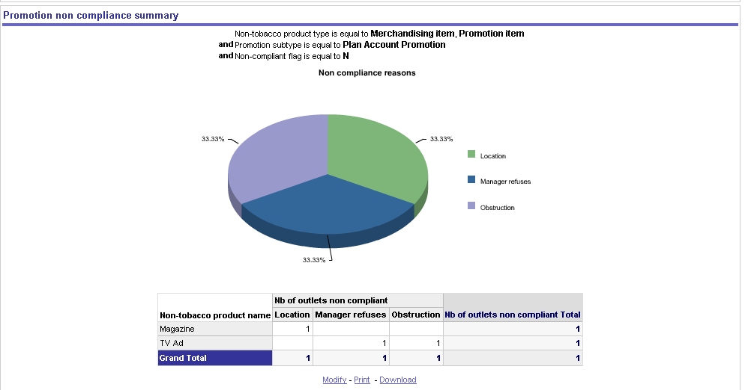
G.9. Measure Promotion Efficiency/Effectiveness
Dashboard – Promotion compliance
Origin for non-compliance
The third report contains a graph and a table showing the amount of times a certain reason for non-compliance occurred.
Siebel Analytics

Slide 53
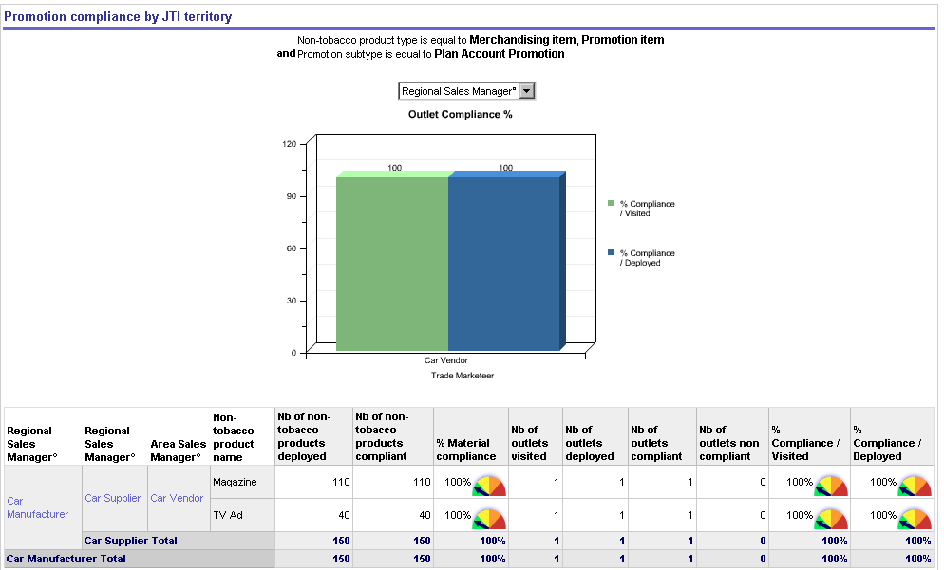
G.9. Measure Promotion Efficiency/Effectiveness
Dashboard – Promotion compliance
1
Siebel Analytics
Analysis of the non-compliance within the Trade Marketer organization
Click on the column selector to either see - The column selector has three values:
  Trade marketer +2 code (Regional)
  Trade marketer +1 code (Area)
  Trade marketer code (Territory)
  The label that will be visible depends on the log in of the user.
To analyze compliance down to outlet level, drill down on Trade Marketing code
2
☺

Slide 54
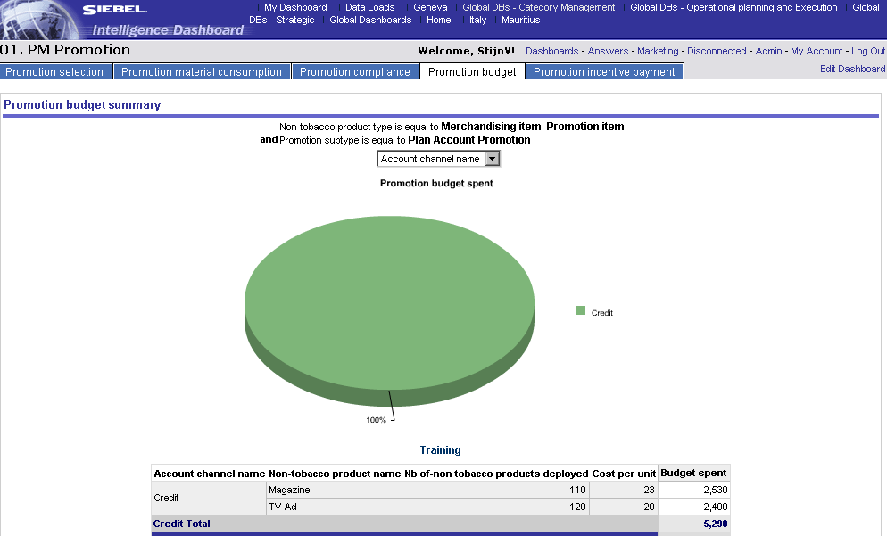
G.9. Measure Promotion Efficiency/Effectiveness
Dashboard – Promotion budget
Track the already spent budget for each promotion article, even for a specific channel.
The “Promotion budget” page tracks the budget spent for the selected program in the page “Promotion Selection”
Change the column selector if you want to see the budget split by channel or by segment (both for graph and table)
1
Siebel Analytics

Slide 55
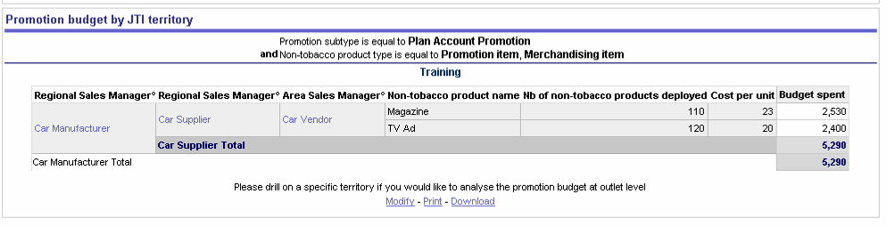
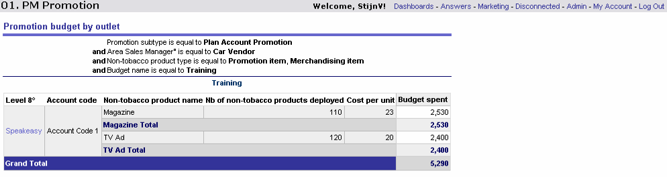
G.9. Measure Promotion Efficiency/Effectiveness
Dashboard – Promotion budget
Track the already spent budget down to outlet level.
This is the bottom of the “Promotion Budget” page
To analyze the budget spent by promotion article down to outlet level, drill down on Trade Marketing code
Siebel Analytics
1
2

Slide 56


G.9. Measure Promotion Efficiency/Effectiveness
Dashboard – Promotion incentive payment
1
2
3
Siebel Analytics
Track the payment of incentives
Go to the “Promotion incentive payment” page
Filter the incentives for a specific channel/segment by selecting a specific “Account channel name” or “Account segment name”
Press “Go”
Drill down on a specific territory if you would like to analyze the incentive payment at outlet level
4

Slide 57
Table of contents
Introduction to Better Practices for Promotion Management
  Definition
  Process Overview
  Capability Interdependencies
Tool support for Promotion Management processes
  JTI versus Siebel Terms
  Tool support
  Tool step overview by BP process
  Tool steps in detail
Demo & Exercises
  Tool demo
  Exercises

Slide 58
Promotion Management
Live demo in Siebel Applications
Story Line
  In Italy, the Grand Prix is taking place in Monza in September 2005. JTI is sponsoring F1 racing through several brands in different teams. Special trade marketing actions have been identified for the non-strategic outlets in the 10 km geographic area around Monza.
  Objectives are set
    A large increase in sales on Winston
    Winston Brand awareness
    Special F1 deco pack and lighters
  The Category Manager is setting up a cluster with temporary deviation to meet the Promotion Objectives.

Slide 59
Promotion Management
Live demo in Siebel Applications
Demo (1/4)
  Insight (from the Category Developer role)
    Reuse existing cluster (created for Assortment and for Space).
  Laptop (from the Category Developer role): review Literature
    Select Literature screen.
    Open various documents related to Promotion, ASP…
  Laptop (from the Category Developer role): Create Budget
    Select Budget screen.
    Create new Budget
  Laptop (from the Category Developer role): Create Promotion Program
    Select Promotion Programs screen.
    Create new Promotion Program record. Complete all fields.
    Link Promotion Program to previously created Budget
    Review timing in the Calendar view

Slide 60
Promotion Management
Live demo in Siebel Applications
Demo (2/4)
  Laptop (from the Category Developer role): define Objectives
    If Objectives already exist
      Select Promotion Program / Objectives view.
      Click New and pick objectives amongst the existing objectives
      Repeat if several objectives apply
    If Objectives are not created, ask Op. Planner to create Objectives in Objective screen.
  Laptop (from the Category Developer role): define Promoted Products
    Select Promotion Programs / Promoted Products view.
    In coherence with Objectives, click New and pick Products to be promoted.
  Laptop (from the Category Developer role): define Promotion Material
    Select Promotion Programs / Promotion Material view.
    Click New and pick Promotion Materials
    Add Quantity and costs. Evaluate total.

Slide 61
Promotion Management
Live demo in Siebel Applications
Demo (3/4)
  Laptop (from the Category Developer role): check Budget
    Select Promotion Programs / Budget view.
    Compare budget available and costs incurred.
  Laptop (from the Category Developer role): Choose accounts for the Promotion Program
    Select Promotion Programs / Target Accounts view.
    Click on Target Account icon in top right corner and pick Target Account List
    Select all accounts and commit.
  Laptop (from the Category Developer role): check Promotion Program deployment
    Navigate to Promotions screen, and Promotions List view.
    Query for the previously created Promotion Program.
    View is n promotions are created according to the n accounts included in the Promotion Program Target Accounts.

Slide 62
Promotion Management
Live demo in Siebel Applications
Demo (4/4)
  Laptop (from the Op. Planner role): create activities for TM
    (this demo only presents simplified method to create activities)
    Select Accounts /Activities view.
    Add a new Activity with Type ‘Place POS Material’.
  Laptop (from the Trade Marketer role): Execute Activity
    Select Accounts /Activities view.
    Review Promotion data before completing activity
      Click on Account/Promotion view
      Drilldown in active promotion (check with Calendar)
      Complete Promotion Material compliance check
      Attribute incentives
  Insight (from the Category Developer role): review Promotion dashboards
    Open Siebel Analytics; click on Global DBs-Category Management dashboards.
    Review all dashboards

Slide 63
Table of contents
Introduction to Better Practices for Promotion Management
  Definition
  Process Overview
  Capability Interdependencies
Tool support for Promotion Management processes
  JTI versus Siebel Terms
  Tool support
  Tool step overview by BP process
  Tool steps in detail
Demo & Exercises
  Tool demo
  Exercises

Slide 64
Tool exercises for Promotion Management
Instructions
Exercises instructions:
  For every item/record created in the Siebel Sales CG application, please complete the record name as follows
    Name provided by the exercise
    +student initials
    +date
Example:
  Creating a new Promotion Program
    Monza Promotion_ADB_20.09.05

Slide 65
Tool exercises for Promotion Management
#1: Create a budget
Log on to the Siebel Application
  Use the following Login details:
    User ID: CTSCMENU
    Password: CSTC?ENU
    Connect to: Siebel Sales
Create Budget
  Go to the Budget screen
    Create a Budget
      Name: Budget Camel 2+1
      Sub type: Promotion Budget
      Period: 2006
      Channel: Leisure (HoReCa)
      Segment: Day HoReCa
      Amount: 5000 €

Slide 66
Tool exercises for Promotion Management
#2: Create a promotion program
Create Promotion Program
  Go to the Promotion Program screen
    Create a Promotion Program
      Name: Camel 2+1
      Promotion type: Consumer Promotion
      Period: 2006
      Brand: Camel
      Budget: Budget Camel 2+1
      Channel: Leisure (HoReCa)
      Segment: Day HoReCa
    Drilldown in the record
  Go to the Promoted Products view. Add 2 products.
  Go to the Objectives view. Add 2 objectives.
  Go to the Promotion Material view. Add 2 Promotion Materials. Enter quantities and costs.
  Go to the Budget view. Compare budget and costs.

Slide 67
Tool exercises for Promotion Management
#3: Apply promotion program to target accounts
Communicate the Promotion Program to accounts
  Go to the Promotion Program screen, go to the Target Accounts view.
    Click on the Target List icon.
      Select 1 target list, click OK
      Select all accounts in the Accounts List
      Click COMMIT
Check Promotion Program communication
  SOLUTION 1: Go to the Accounts screen.
    Search for 1 of the Accounts included in the previous Target List.
    Go to the Account/Promotion view. Check if Promotion is visible.
  SOLUTION 2: Go to the Promotions screen.
    In the Promotion Program field, query for the previously created Promotion Program.
    The program should appear as many times as there were accounts in the Target List.

Slide 68
Summary : Learning objectives of this module
You are now able to
  Understand how the TME applications support the BP processes for Promotion Management
  Create Clusters in Siebel Marketing and use them in Siebel Sales CG
  Create Promotions Programs and cascade them to multiple accounts
  Review Promotion data in Siebel Analytics
Notes:
Review key objectives as documented on the slide with your participants.
The Better Practices based on the 10 capabilities will require New ways of working and the IT systems and tools will support and enable them!

Slide 69
Next steps after the training session
Based on what you have learned, your next steps are
  Familiarize with the Siebel applications
  Execute the Self-Paced exercises available on the TME University Portal
  Localize training material
  Train other users in your market
  Attend more upcoming intermediate and advanced trainings to complete your knowledge of Promotion Management

